Slide 1
JAVA Encapsulation-Getters and Setters
Lecturer: Jay A. Abaleta

Slide 2
What is Encapsulation?
Encapsulation in Java is a mechanism of wrapping the data (variables) and code acting on the data (methods) together as a single unit.
The meaning of Encapsulation, is to make sure that "sensitive" data is hidden from users.
Therefore, is an OOP technique use to hide data from direct access

Slide 3
Encapsulation Goal
Declare the variables of a class as private.
Provide public setter and getter methods to modify and view the variables values.
The public setXXX() and getXXX() methods are the access points of the instance variables of the Encapsulation class.

Slide 4
Why Encapsulation?
Encapsulation helps us to keep related fields and methods together, which makes our code cleaner and easy to read.
The getter and setter methods provide read-only or write-only access to our class.
getName() // provides read-only access
setName() // provides write-only access
Flexible: the programmer can change one part of the code without affecting other parts
Increased security of data

Slide 5
The Getters and Setters
Getter and Setter are methods used to protect your data and make your code more secure.
Getter and Setter make the programmer convenient in setting and getting the value for a particular data type.

Slide 6
Use of Getters and Setters
Encapsulation: Getters and setters allow you to keep the fields of a class private while providing controlled access to them through public methods.
Controlled Access: With setters, you can enforce validation or constraints on the values before assigning them. Getters can format or process data before returning it.
Consistency: You can ensure that when a value is modified or accessed, certain conditions are met, which can help maintain the consistency of the object’s state.
Flexibility: In the future, you can modify the internal implementation without changing the external interface.

Slide 7
The Getter
Getter returns the value (accessors), it returns the value of data type int, String, double, float, etc.
For the program’s convenience, the getter starts with the word “get” followed by the variable name.

Slide 8
The Setters
Setter in Java: While Setter sets or updates the value (mutators).
It sets the value for any variable used in a class’s programs. and starts with the word “set” followed by the variable name.

Slide 9
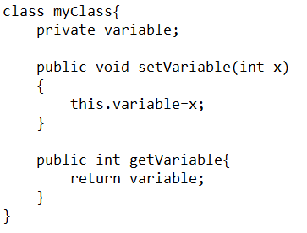
Syntax for Getters and Setters

Slide 10
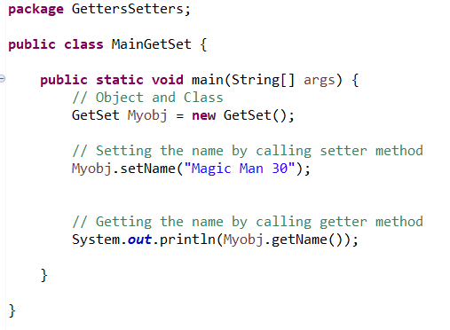
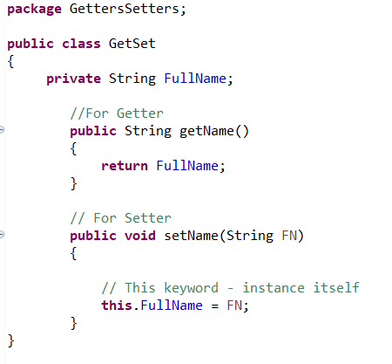
Example: Getters and Setters

Slide 11

Encapsulation Syntax
<Access_Modifier> class <Class_Name>
{
private <Data_Members>;
private <Data_Methods>;
}

Slide 12
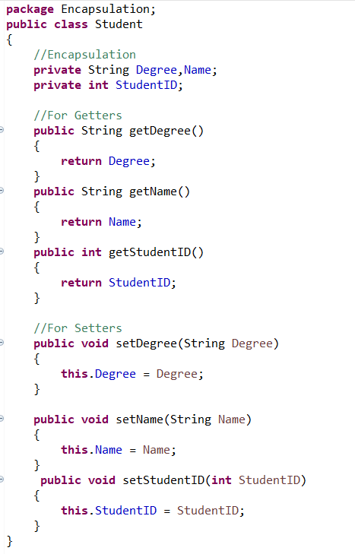
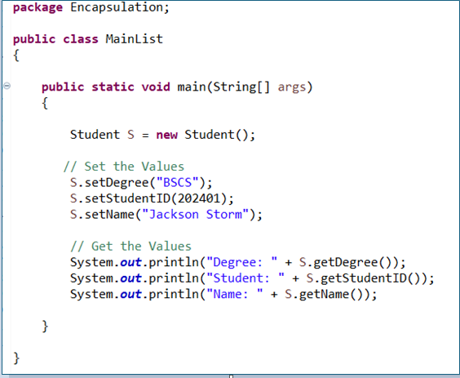
Example: Encapsulation

